Slide 1
Offshore Wind: Federal Process and Timeline
Jenny Netherton
Southeastern Wind Coalition

Slide 2
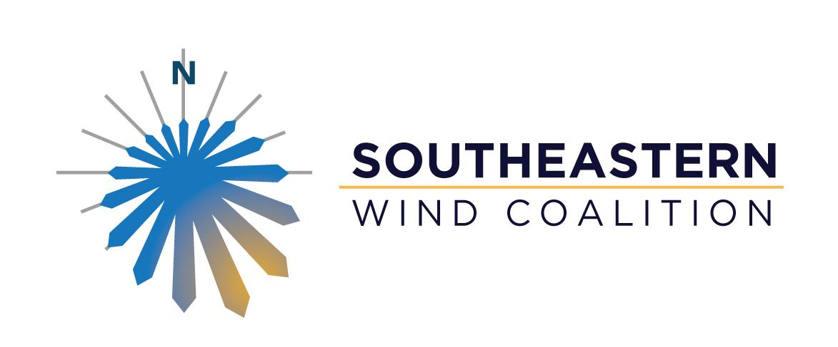
Our mission is to advance the wind industry in ways that result in net economic benefits to utilities, residents, and ratepayers. The Coalition takes an objective, data-driven, and economic development focused approach to ensure the Southeast can take advantage of this clean, low-cost generation source.
Our key members include industry (e.g. manufacturers, utilities, suppliers, developers, consultants, service providers), appropriate government bodies (economic developers, commerce departments, energy offices), academic and research institutions, and other non-profit groups that share our objectives.
The Southeastern Wind Coalition is a 501(c)(3) nonprofit organization.

Slide 3
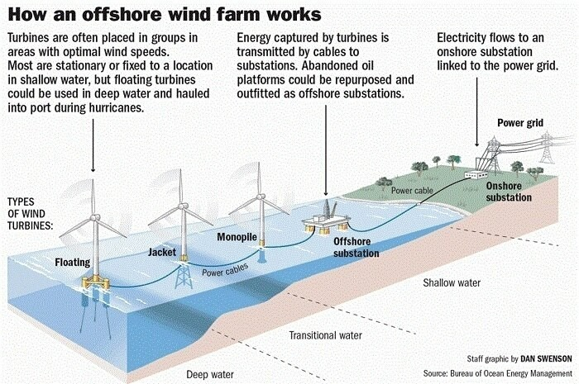
Source: Bureau of Ocean Energy Management

Slide 4
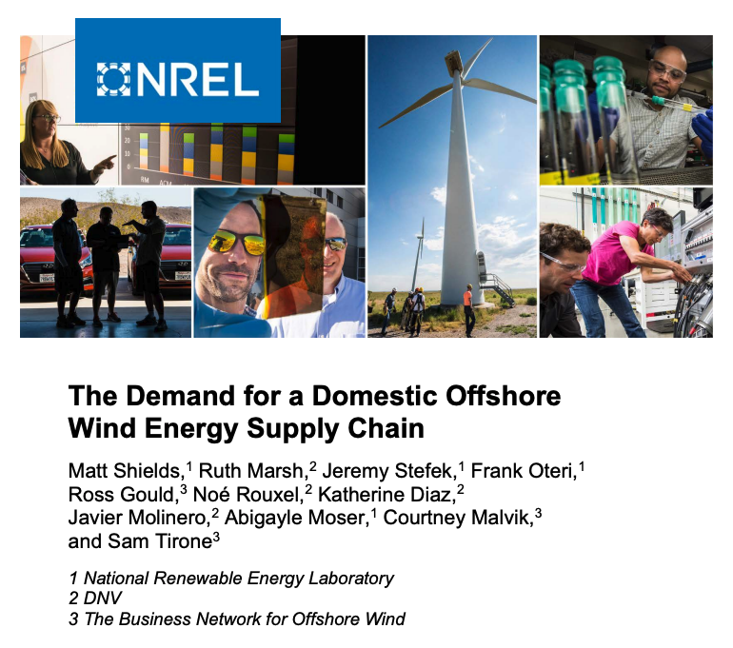
Source: https://www.nrel.gov/docs/fy22osti/81602.pdf

Slide 5
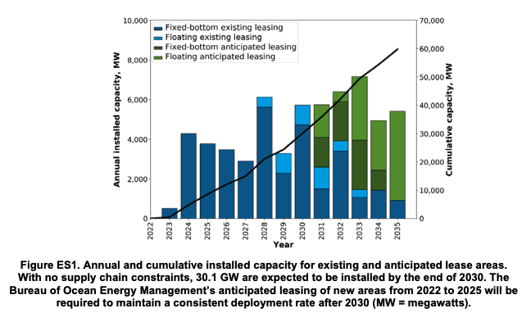
Source: https://www.nrel.gov/docs/fy22osti/81602.pdf

Slide 6
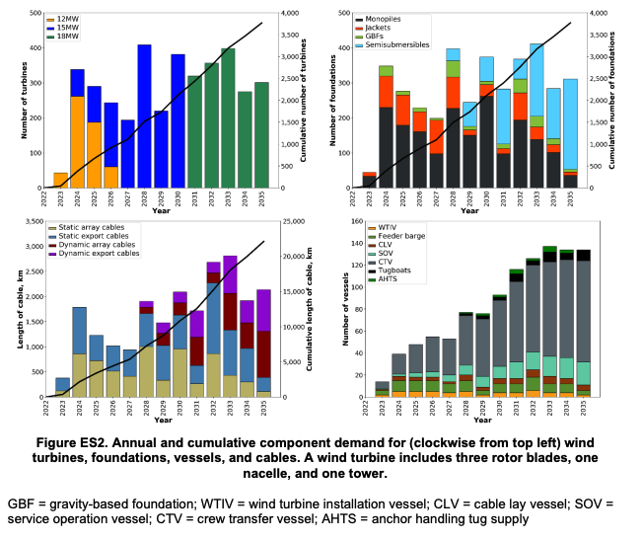
Source: https://www.nrel.gov/docs/fy22osti/81602.pdf

Slide 7
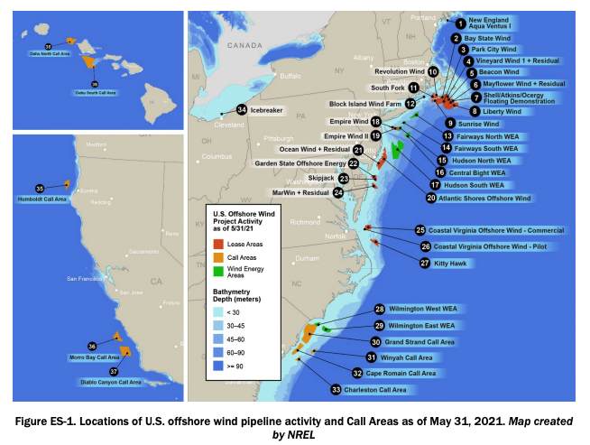
Source: Offshore Wind Market Report (2021 Edition), US Department of Energy

Slide 8
BOEM Federal Leasing Timeline
Source: Bureau of Ocean Energy Management

Slide 9
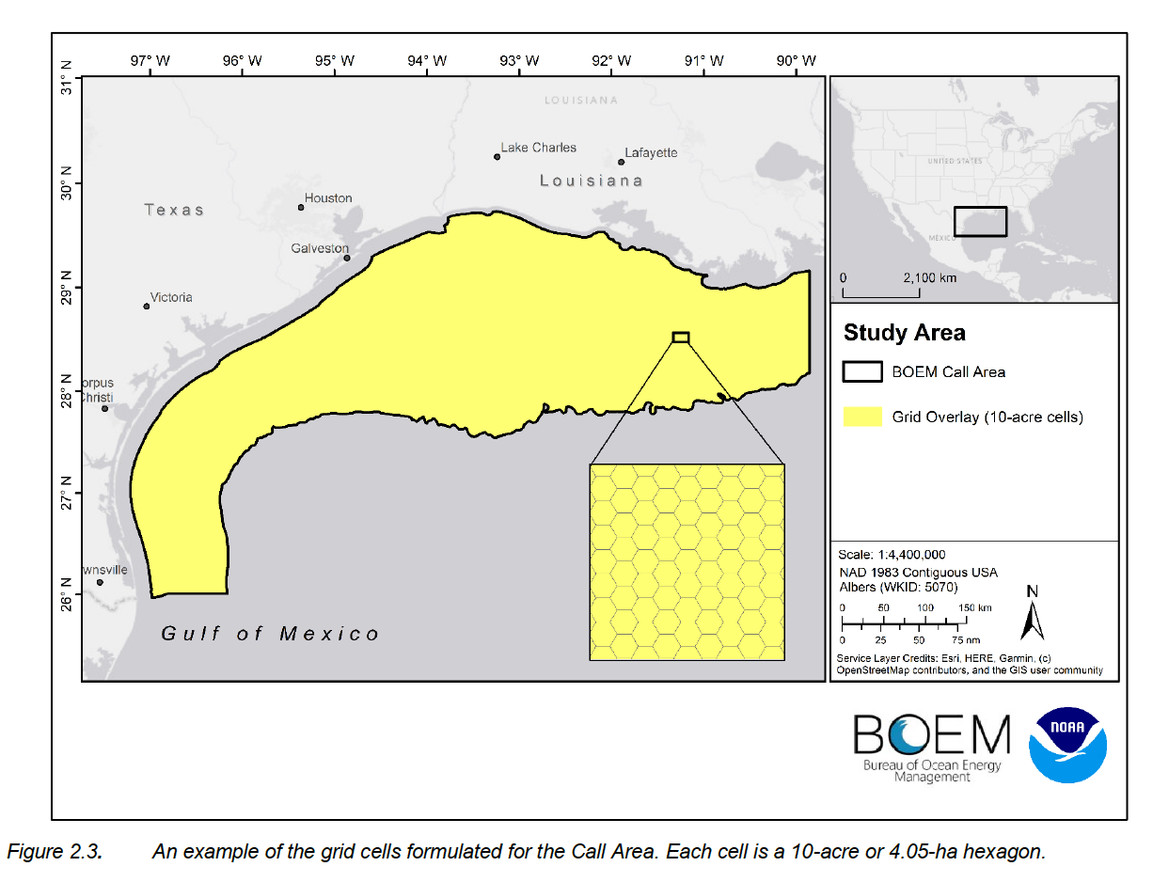

Slide 10
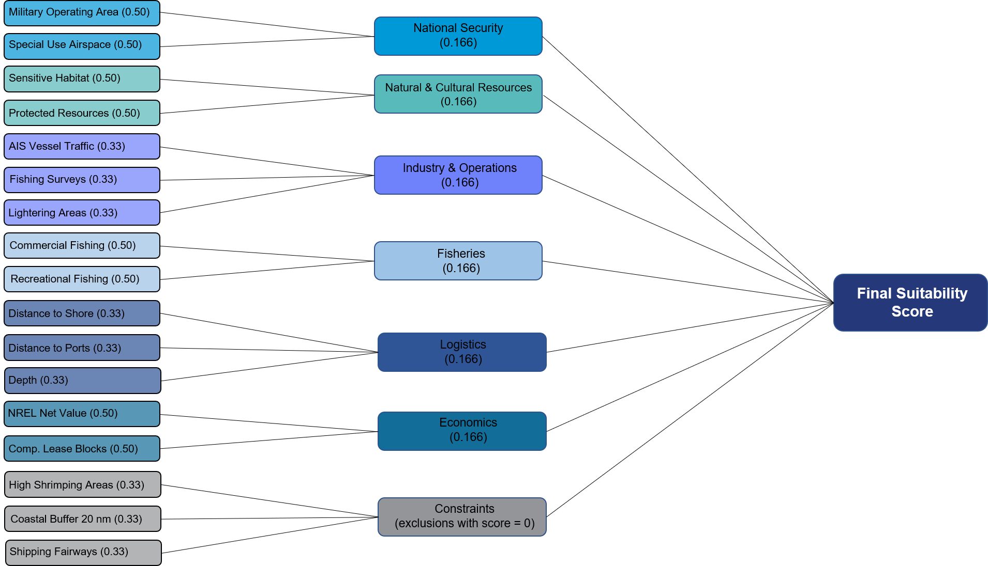
Source: Gulf of Mexico Wind Energy Area Memorandum, BOEM

Slide 11
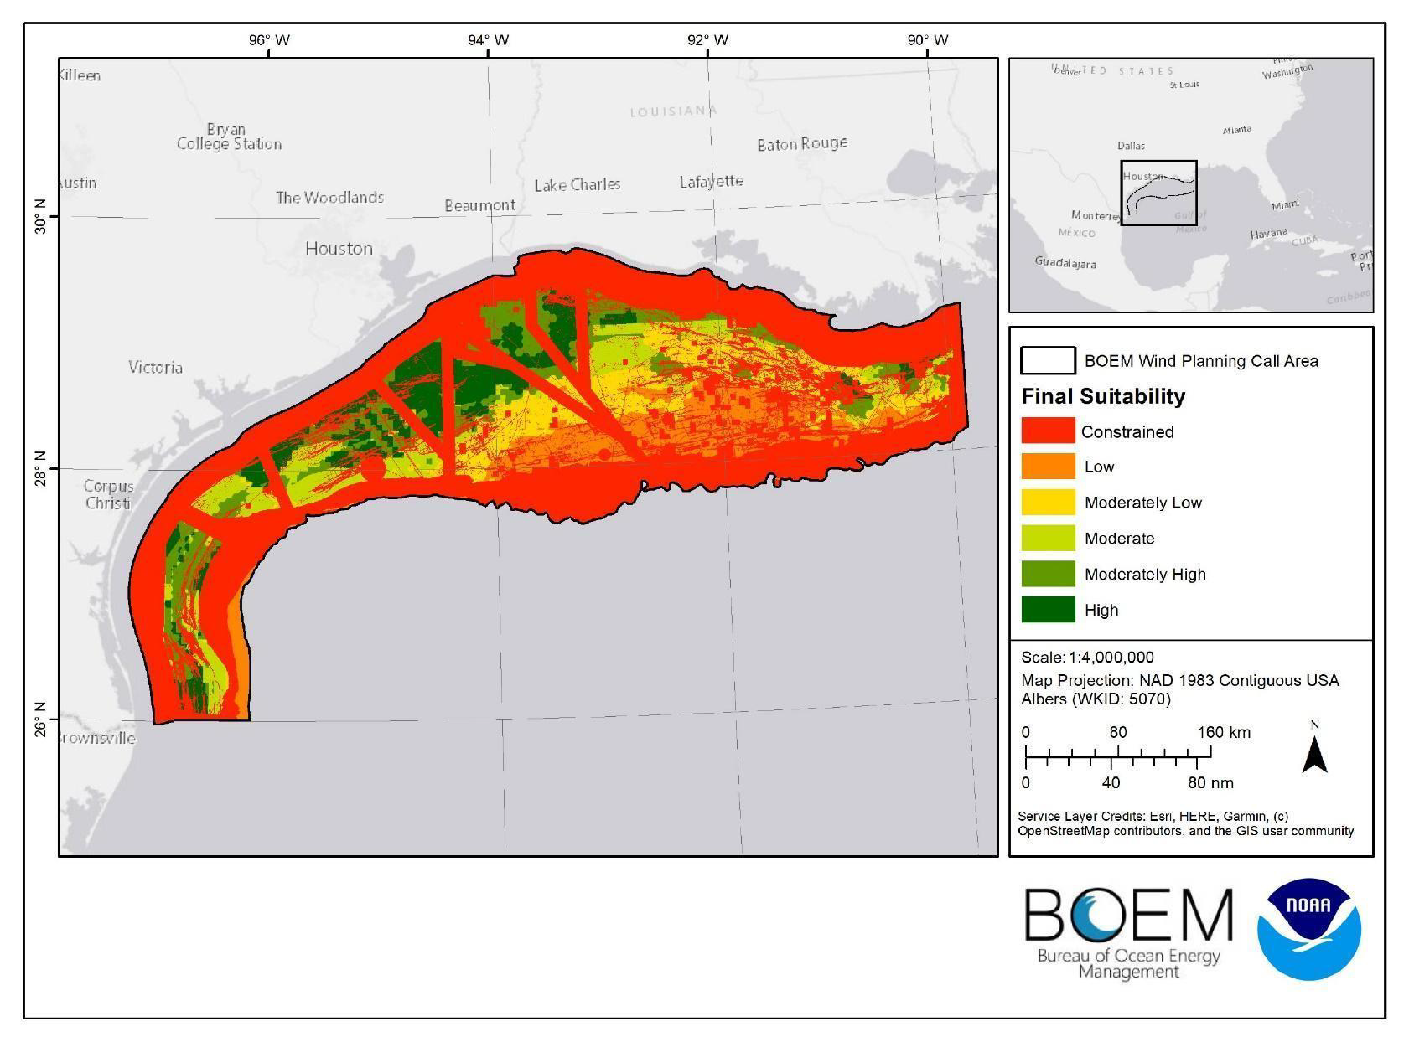

Slide 12
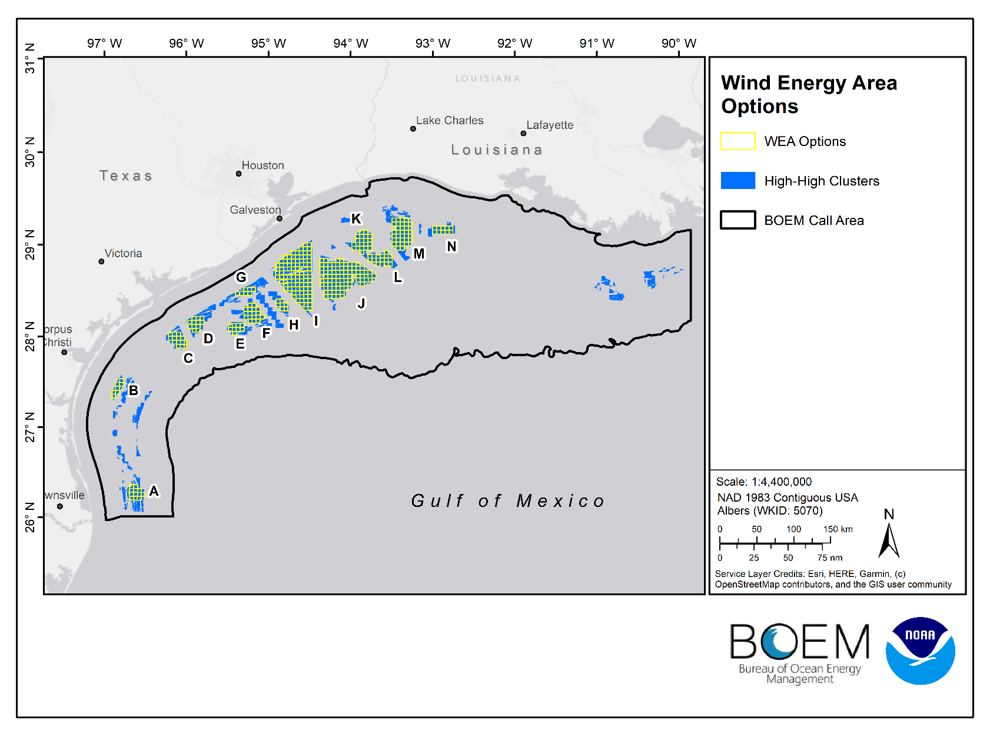

Slide 13
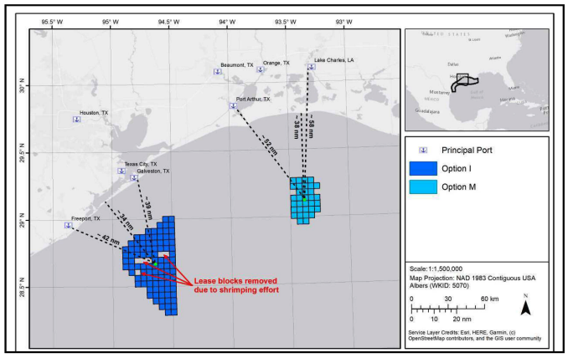
Source: https://www.boem.gov/sites/default/files/documents/renewable-energy/state-activities/4683-Memorandum-for-Area-ID-GOM.pdf

Slide 14
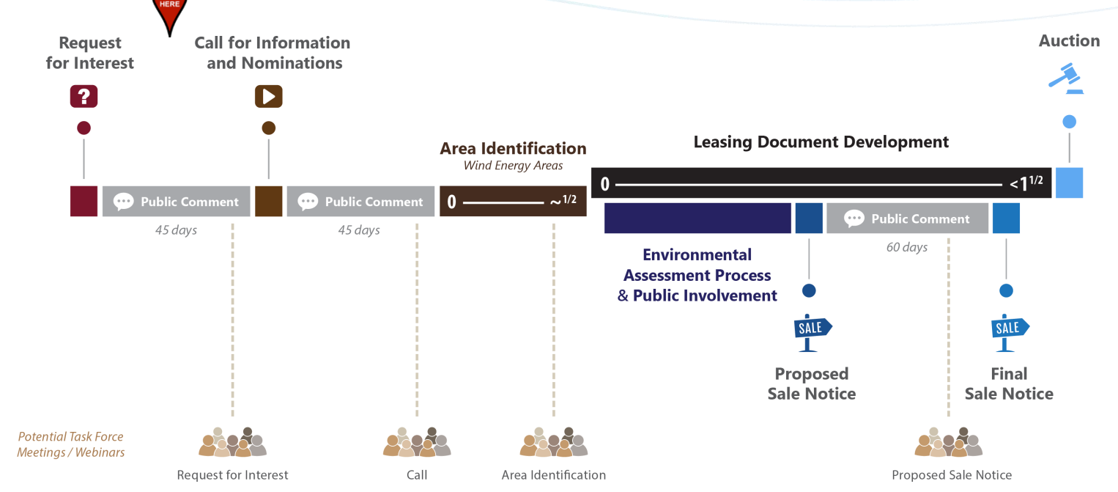

Slide 15
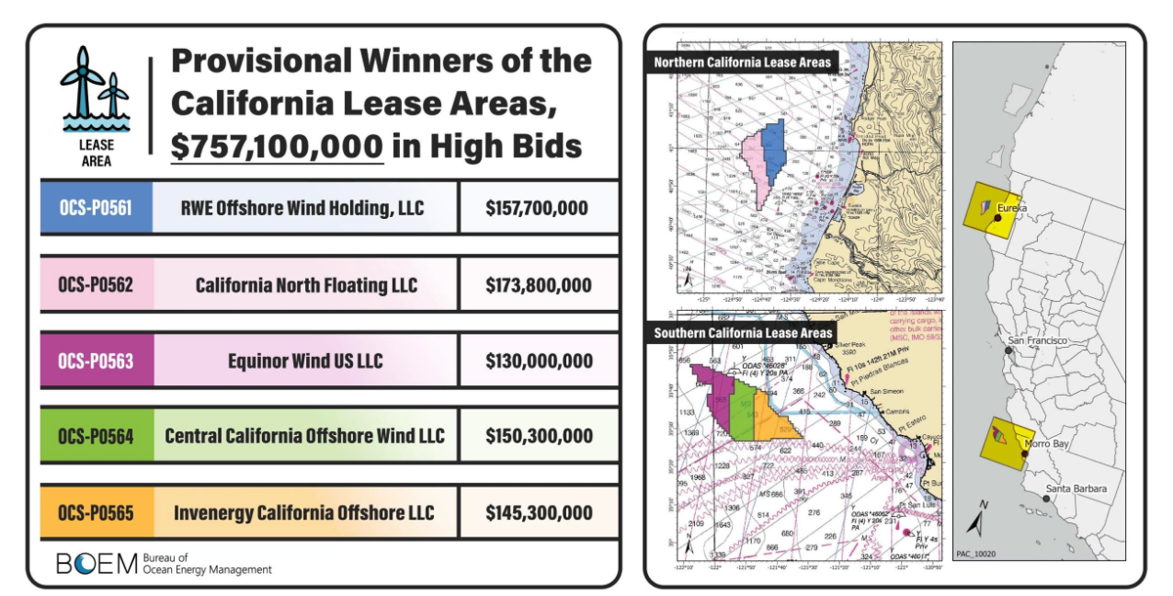
Source: https://www.boem.gov/renewable-energy/state-activities/california

Slide 16
California Bidding Credits After Comment
5% bidding credit for bidders who have committed to a qualifying General Community Benefit Agreement (CBA)
5% credit offered for the Lease Area Use CBA bidding credit
20% credit for workforce development and supply chain development in floating offshore wind
The opportunity to comment on the Gulf of Mexico Proposed Sale Notice is the next avenue for engagement
Source: Final Sale Notice for California OCS Leasing (87 FR 64093)

Slide 17
Opportunities for Louisiana
Workforce Development
UNO Wind Hub, Delgado, Nunez Community College
Supply Chain
The US does not have a strong supply chain yet and Louisiana has the experience
Ports and Harbors
Opportunity for long-term engagement in conjunction with the supply chain and operations
Transmission
Opportunity for improvements to the grid and storm resilience
Environmental Considerations
Coastal Master Plan, avian impacts, distance from shore
Fishing and Maritime Industry
Engaging stakeholders to ensure areas are of least impact
Innovation and Technology
Blade manufacturers, demand for boats, academic research

Slide 18
Jenny Netherton
jennyn@sewind.org
(318) 470-1144

